Slide 1
Text Based Adventure Game
By Andrew Kish and Patrick McDoniel

Slide 2

UML Diagrams

Slide 3
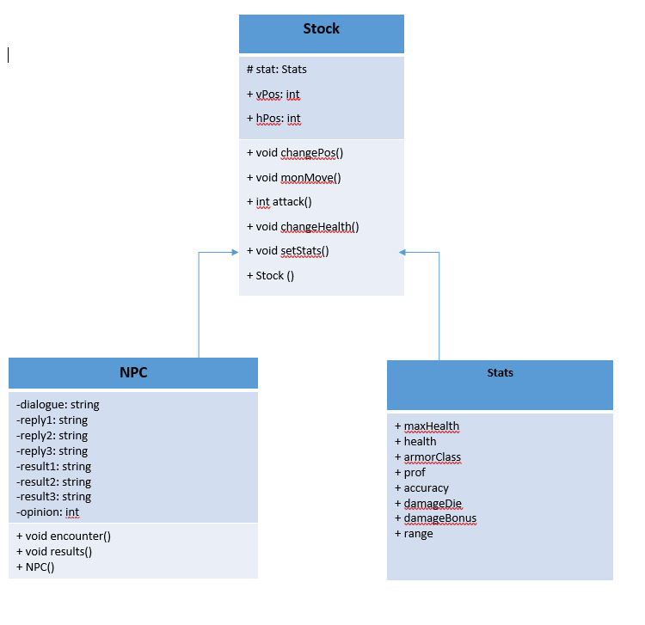

Slide 4
Style Guide
All #include statements at the top of the files
Space between each main function
All class definition in header files
All connected functions on same file
Comments explaining variables at first instance in code
Comment explaining loops/if statements at top of statement
Arbitrary empty lines for readability for users

Slide 5
Code Demonstration
Executing code creates text based adventure game, good luck!

